Slide 1
Bayesian Inference
Module 5, Lesson 1
Notes:
Welcome to Lesson 1 of Module 5 on Bayesian Inference.

Slide 2
Parameterized Priors and Exchangeability
Shahrzad Jamshidi, PhD
Notes:
In this lesson, we will explore parameterized priors and the concept of exchangeability in Bayesian models.

Slide 3
Last Time
Large-Sample Inference
Notes:
Last time, we covered large-sample inference

Slide 4
Objectives
Learn how to construct parameterized prior distributions.
Understand the concept of exchangeability and its role in hierarchical models.
Notes:
By the end of this lesson, you will
learn how to construct parameterized prior distributions and
understand the concept of exchangeability and its role in hierarchical models.

Slide 5
Topics to Review
The Beta Distribution
Mixture Distributions
Notes:
Topics to review for this lesson include
the Beta distribution and
Mixture distributions

Slide 6

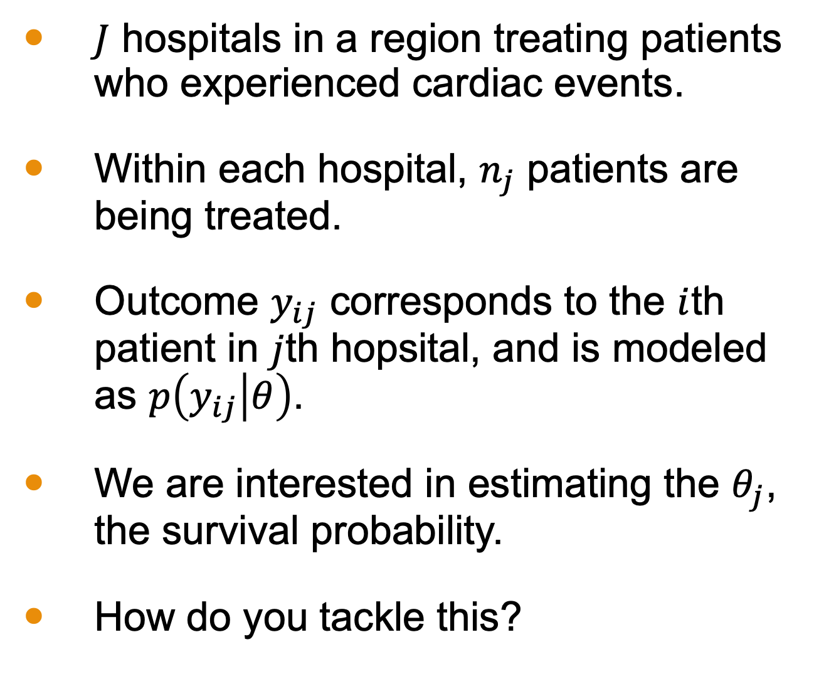
An Example to Consider
$J$ hospitals in a region treating patients who experienced cardiac events.
Within each hospital, $n_{j}$ patients are being treated.
Outcome $y_{ij}$ corresponds to the $i$th patient in $j$th hopsital, and is modeled as $p\left(y_{ij} | θ\right)$.
We are interested in estimating the $θ_{j}$, the survival probability.
How do you tackle this?
Microsoft Stock Images
Notes:
Let’s consider an example involving hospitals in a region treating patients who experienced cardiac events. Each hospital treats a number of patients, and we are interested in estimating the survival probability for these patients. The challenge is how to tackle this estimation using Bayesian methods.
Suppose there are J hospitals in the region
Within each hospital, there are n_j patients being treated for cardiac events
Each patient in each hospital has an outcome of survival denoted y_ij
And we are interested in estimated the parameter theta_j, the probability of survival.
How would you tackle such a problem?

Slide 7
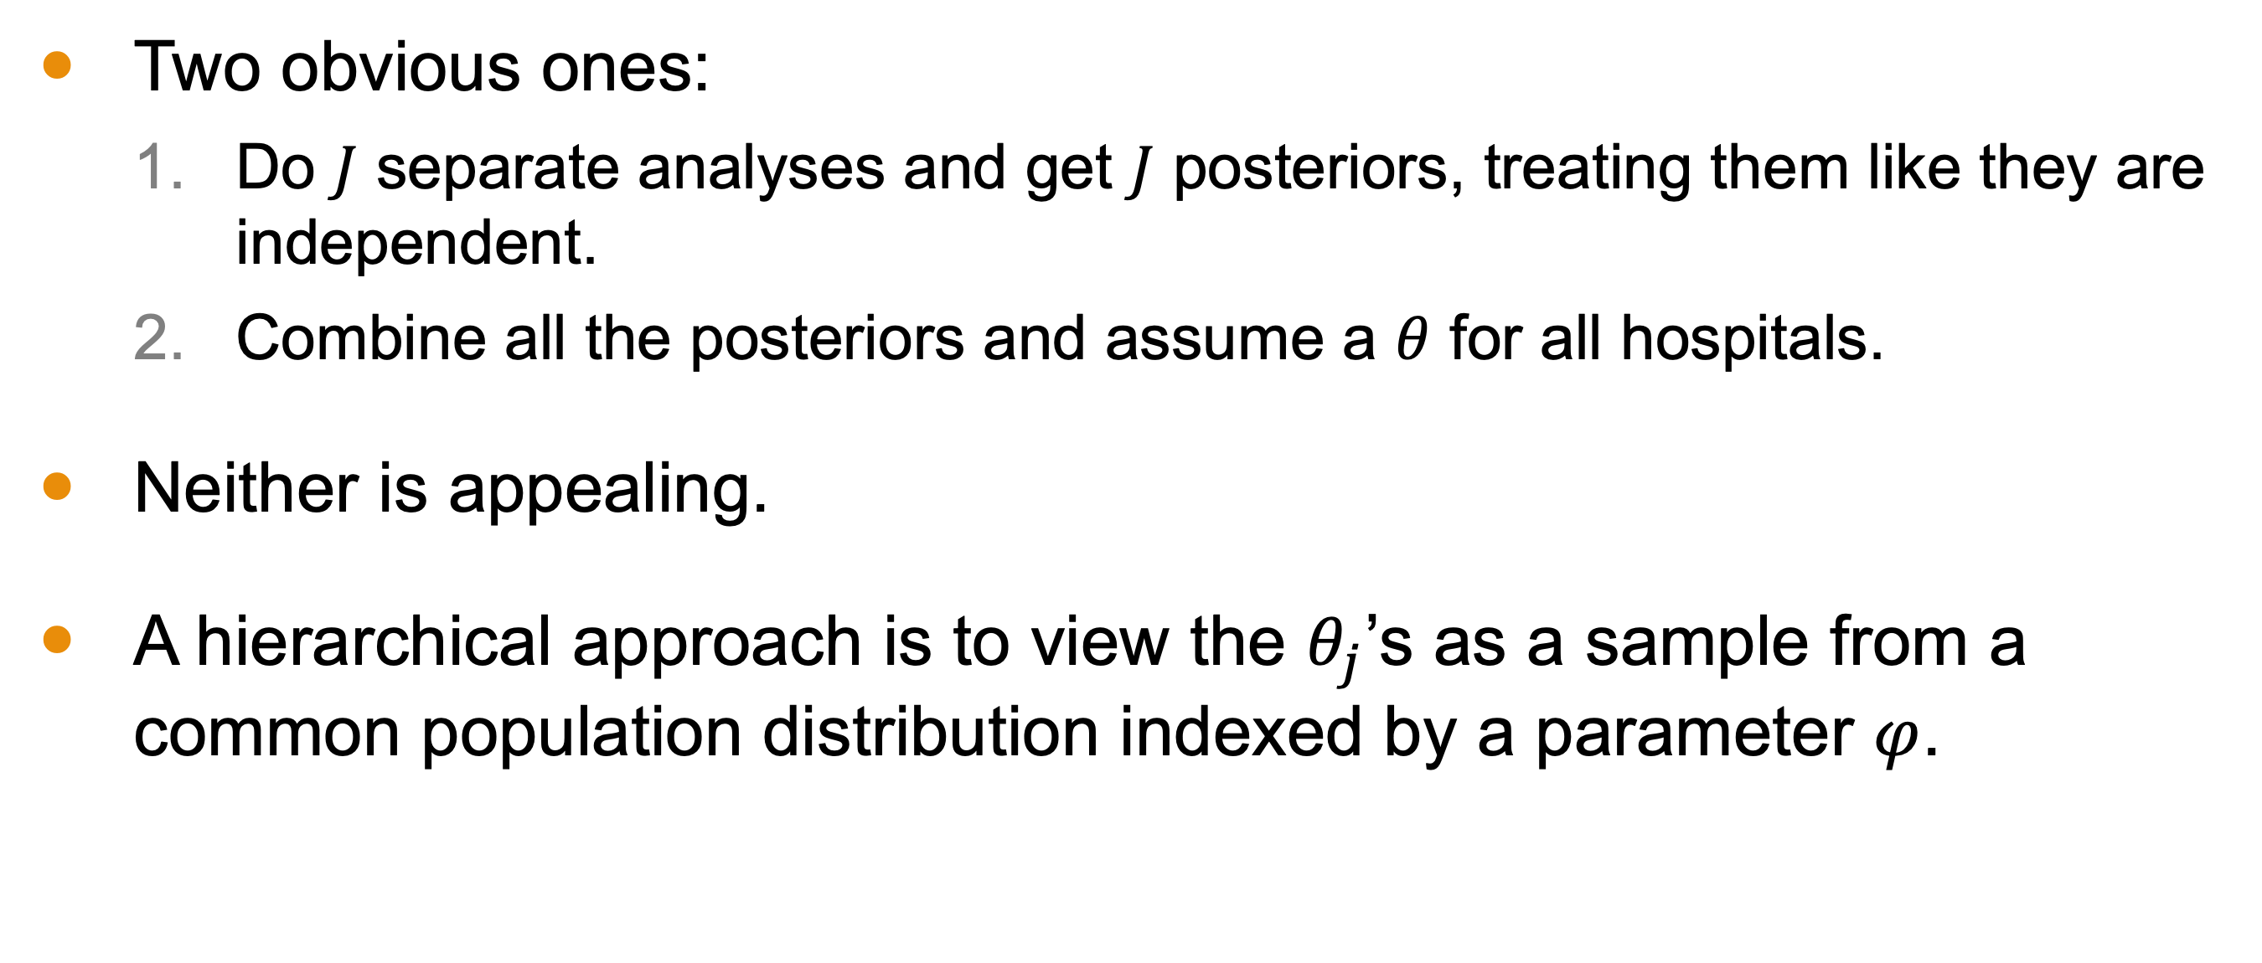
Possible Approaches
Two obvious ones:
Do $J$ separate analyses and get $J$ posteriors, treating them like they are independent.
Combine all the posteriors and assume a $θ$ for all hospitals.
Neither is appealing.
A hierarchical approach is to view the $θ_{j}$’s as a sample from a common population distribution indexed by a parameter $φ$.
Notes:
There are two obvious approaches:
1. Conducting separate analyses for each hospital and treating them as independent.
2. Combining all the data and assuming a common survival probability for all hospitals.
Neither approach is appealing because these experiments clearly have a relationship to one another but they aren’t identical.
Instead, we use a hierarchical approach, viewing the survival probabilities from each hospital as a sample from a common population indexed by some parameter, possibly a set of parameters.

Slide 8
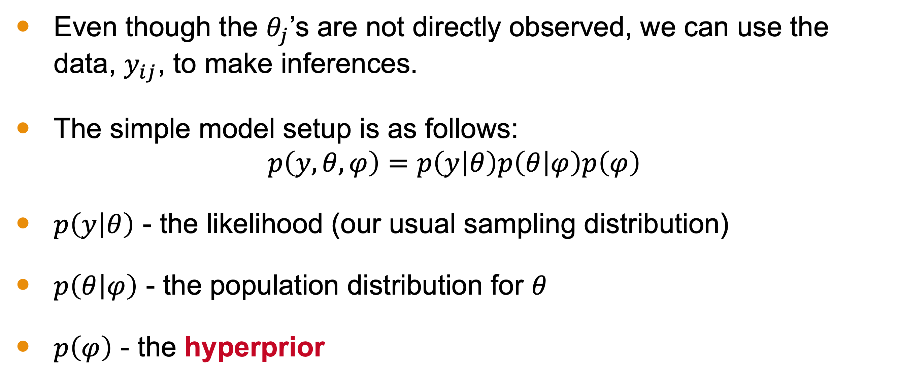
Hierarchical Approach
Even though the $θ_{j}$’s are not directly observed, we can use the data, $y_{ij}$, to make inferences.
The simple model setup is as follows:
$$p\left(y,θ,φ\right)=p\left(y | θ\right)p\left(θ | φ\right)p\left(φ\right)$$
$p\left(y | θ\right)$ - the likelihood (our usual sampling distribution)
$p\left(θ | φ\right)$ - the population distribution for $θ$
$p\left(φ\right)$ - the hyperprior
Notes:
Even though the survival probabilities are not directly observed, we can use the data to make inferences.
The hierarchical model setup includes:
A joint distribution made up of
• The likelihood (our usual sampling distribution)
• The population distribution for the parameters
• The hyperprior

Slide 9
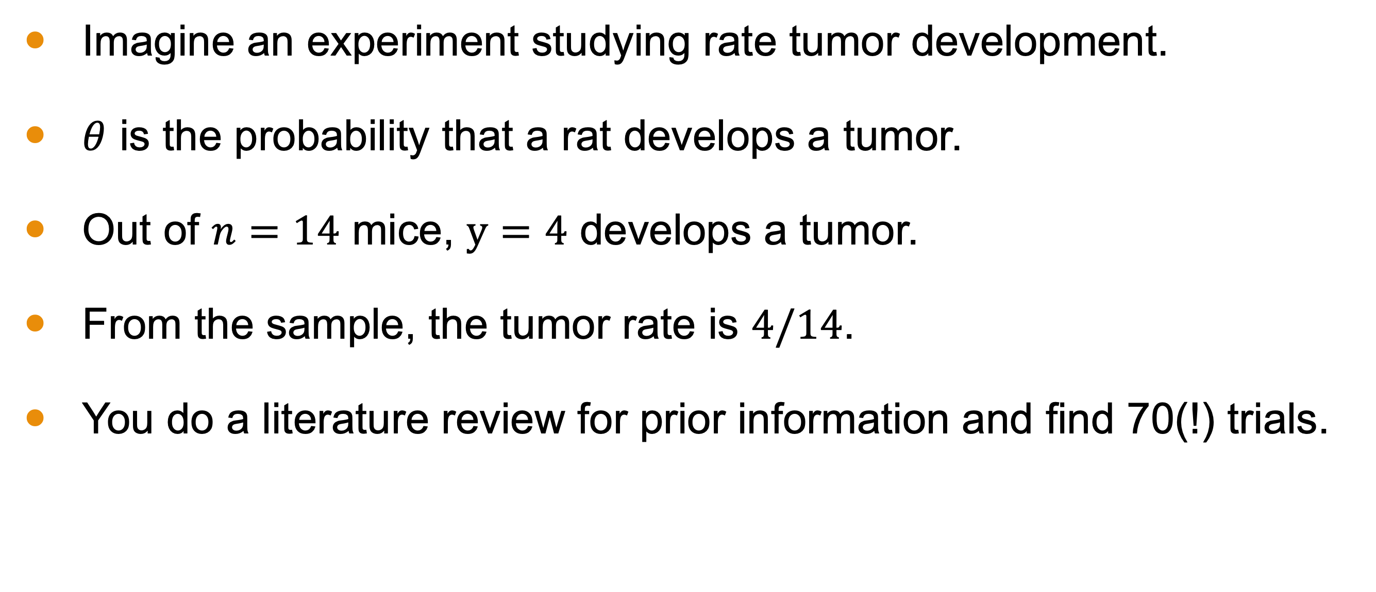
Prior Construction Example
Imagine an experiment studying rate tumor development.
$θ$ is the probability that a rat develops a tumor.
Out of $n=14$ mice, $y=4$ develops a tumor.
From the sample, the tumor rate is $4/14$.
You do a literature review for prior information and find 70(!) trials.
Notes:
Let's imagine a study aiming to estimate the probability of developing an endometrial stromal polyps—a type of tumor—in female rate, type ‘F344’.
We are interested in the probability that a rat develops a tumor.
From a sample of rats, we observe
the tumor rate (4/14) and
gather prior information from literature involving 70 previous studies. This information is what we wish to use to construct a prior distribution.

Slide 10
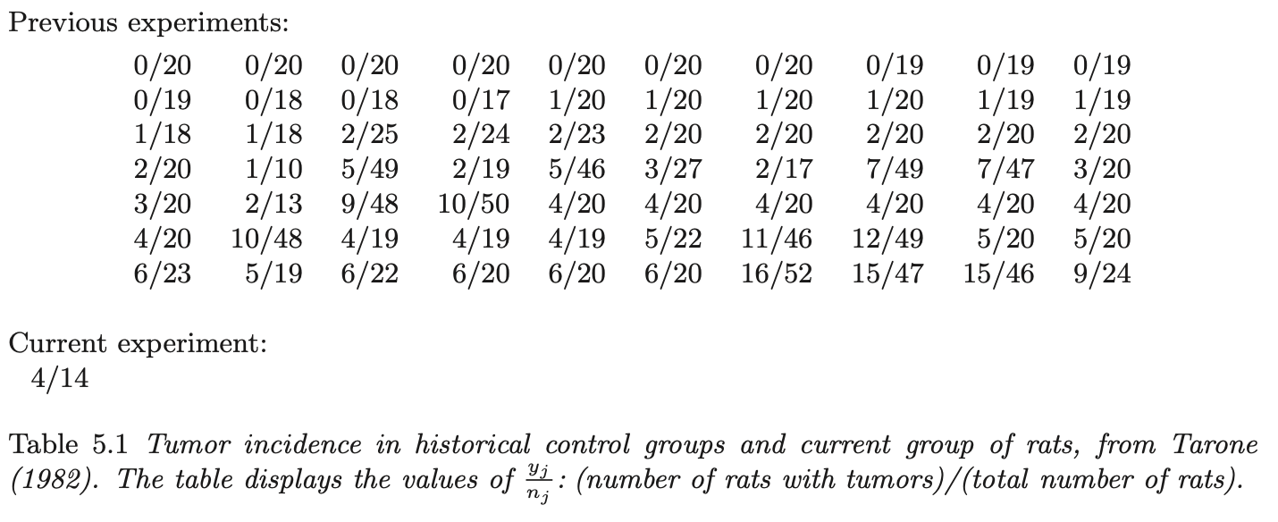
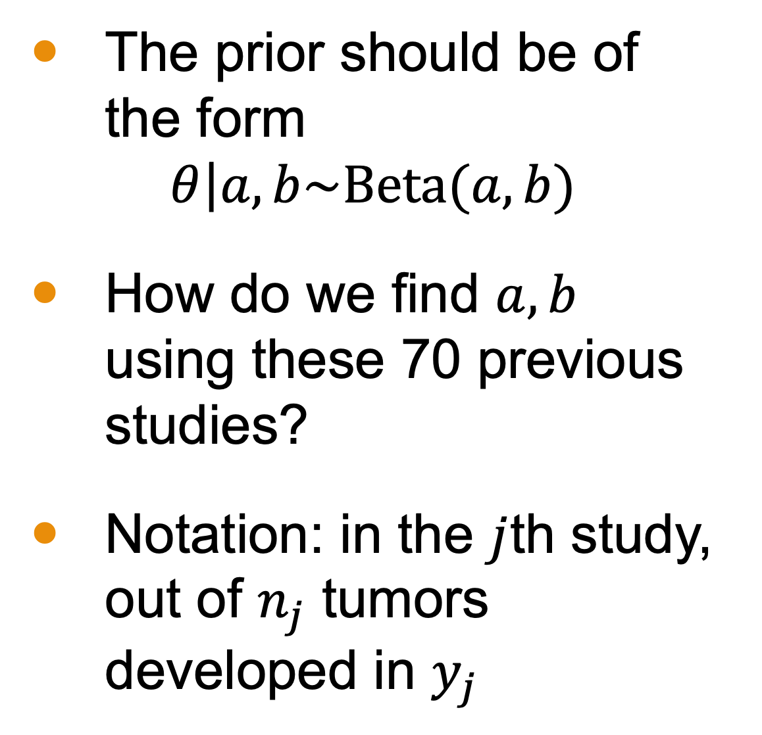
Prior Construction Set Up
The prior should be of the form
$$\left.θ\right|a,b\sim \text{Beta}(a,b)$$
How do we find $a,b$ using these 70 previous studies?
Notation: in the $j$th study, out of $n_{j}$ tumors developed in $y_{j}$
Taken from BDA3
Notes:
Because this is binary data,
the prior distribution should be a
Beta distribution.
How should we find the parameters of this prior distribution?
Just to clarify our discussion … The notation is such that j indexes the study. Y_j are the number of rats that developed a tumor out of n_j. So we might think of y_1 = 0 and n_1 = 20 according to the table on the right.

Slide 11
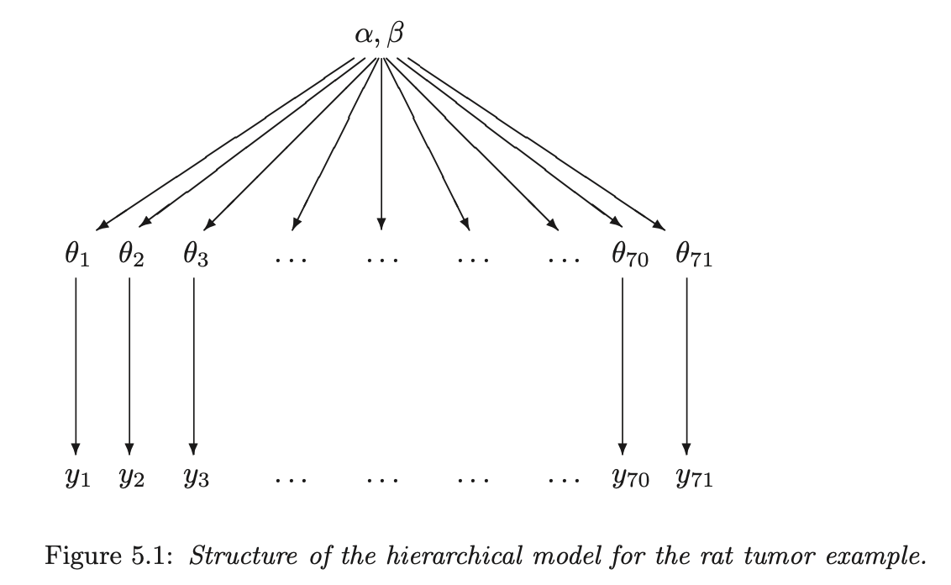
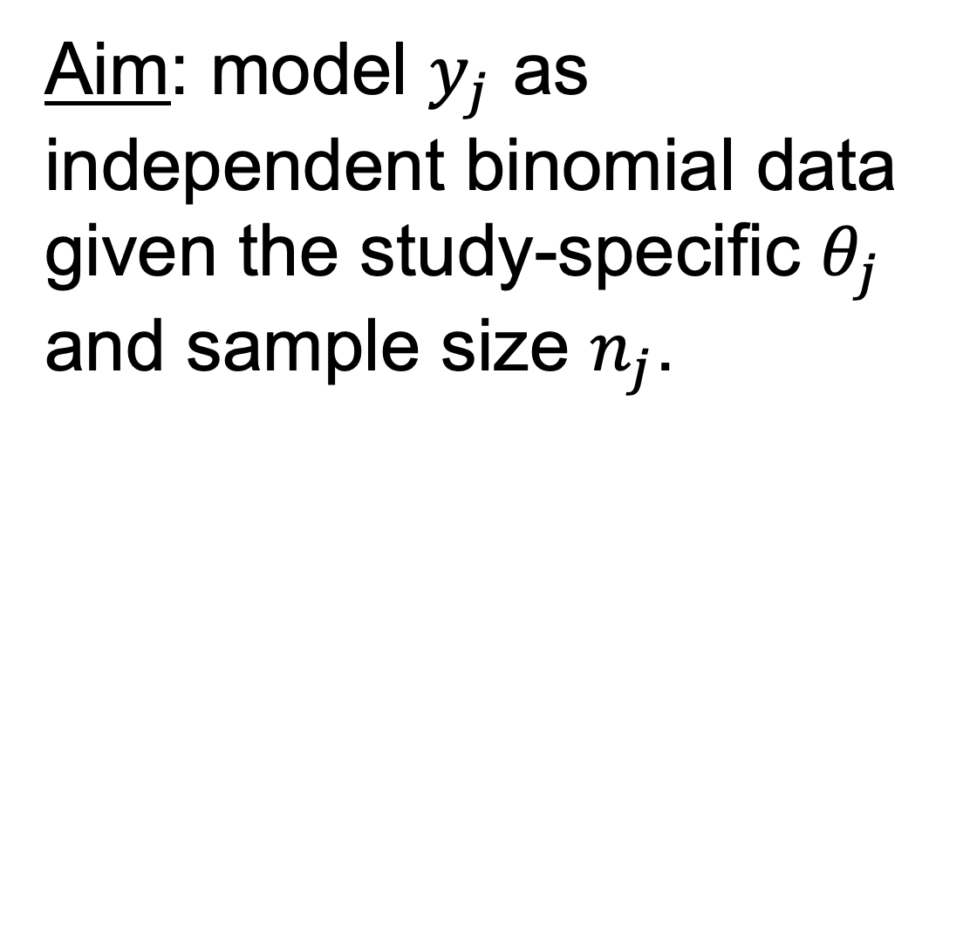
Prior Construction Idea
Aim: model $y_{j}$ as independent binomial data given the study-specific $θ_{j}$ and sample size $n_{j}$.
Taken from BDA3
Notes:
Our aim is to model $y_{j}$ as independent binomial data based on $θ_{j}$, the study-specific parameter and sample size $n_{j}$.
The image on the left represents the concept of a hierarchical model for this example. We assume that the Beta(α, β) is a good population distribution for all these θj from the past experiments. The observable data is then generated from those parameters in each experiment.

Slide 12
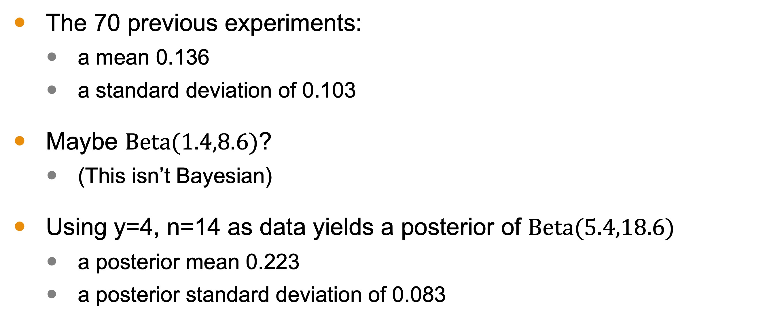
Rough Computation
The 70 previous experiments:
a mean 0.136
a standard deviation of 0.103
Maybe $Beta(1.4,8.6)$?
(This isn’t Bayesian)
Using y=4, n=14 as data yields a posterior of $Beta(5.4,18.6)$
a posterior mean 0.223
a posterior standard deviation of 0.083
Notes:
Let's say we treat these 70 historical experiments as points in a dataset. Then this
dataset has mean 0.136 and standard deviation 0.103. We presume this data come from a Beta distribution, so perhaps
the prior is Beta(1.4, 8.6) to get correspondence with our sample.
This is not a Bayesian calculation because it is not based on any specified full probability model.
Then using our data from experiment 71, we can compute a posterior of Beta(5.4, 18.6).
These analyses require that the current tumor risk, θ_71, and the 70 historical tumor
risks, θ_1,...,θ_70, be considered a random sample from a common distribution, an
assumption that would be invalidated, for example, if it were known that the historical
experiments were all done in laboratory A but the current data were gathered in
laboratory B, or if time trends were relevant.

Slide 13
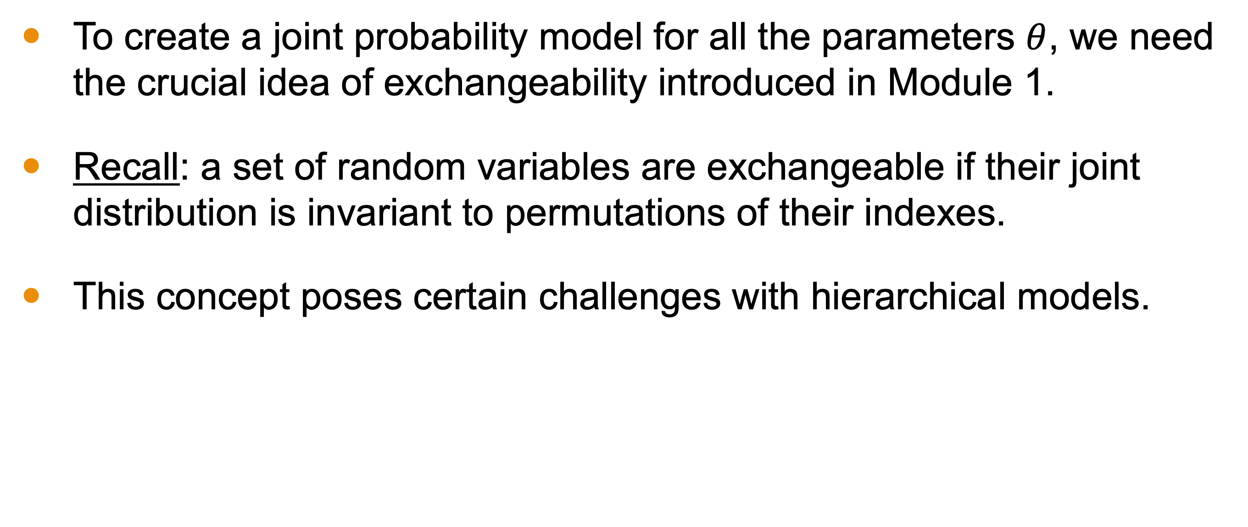
Exchangeability
To create a joint probability model for all the parameters $θ$, we need the crucial idea of exchangeability introduced in Module 1.
Recall: a set of random variables are exchangeable if their joint distribution is invariant to permutations of their indexes.
This concept poses certain challenges with hierarchical models.
Notes:
To create a joint probability model for all the parameters, we need the concept of exchangeability.
A set of random variables is exchangeable if their joint distribution is invariant to permutations of their indexes.
This concept is challenging in hierarchical models due to contextual variability. Even in our previous example, it may not be true.

Slide 14
Central Challenge: Contextual Variability
Hierarchical modes rely on groupings
Those groups may exist in different contexts undermining exchangeability.
Example: The hierarchical model estimating the effectiveness of a new treatment across multiple hospitals.
Exchangeability implies that the hospitals are similar in terms of patient demographics, treatment protocols, and other contextual factors.
This may not hold
Notes:
Hierarchical models rely on groupings,
and these groups may exist in different contexts, undermining exchangeability.
For example, in a model estimating treatment effectiveness across hospitals,
exchangeability implies that hospitals are similar in terms of patient demographics and treatment protocols,
but that may not hold true.

Slide 15
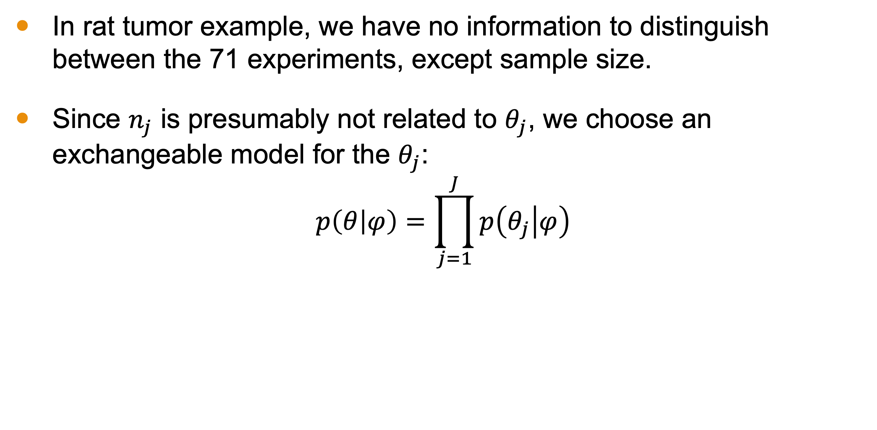
Rat Tumor Example
In rat tumor example, we have no information to distinguish between the 71 experiments, except sample size.
Since $n_{j}$ is presumably not related to $θ_{j}$, we choose an exchangeable model for the $θ_{j}$:
$$p\left(θ | φ\right)=\prod_{j=1}^{J}{p\left(θ_{j} | φ\right)}$$
Notes:
In the rat tumor model, the experiments appear to have the similar contexts—we know nothing to suggest that they are different, which would imbue some meaning into the indexes. Hence it lacks the contextual variability that would undermine exchangeability.
The real difference we see with each sample is that the sample size is not uniform; however, this should not influence the hidden parameter. So we can construct an exchangeable model based on some parameter phi.

Slide 16

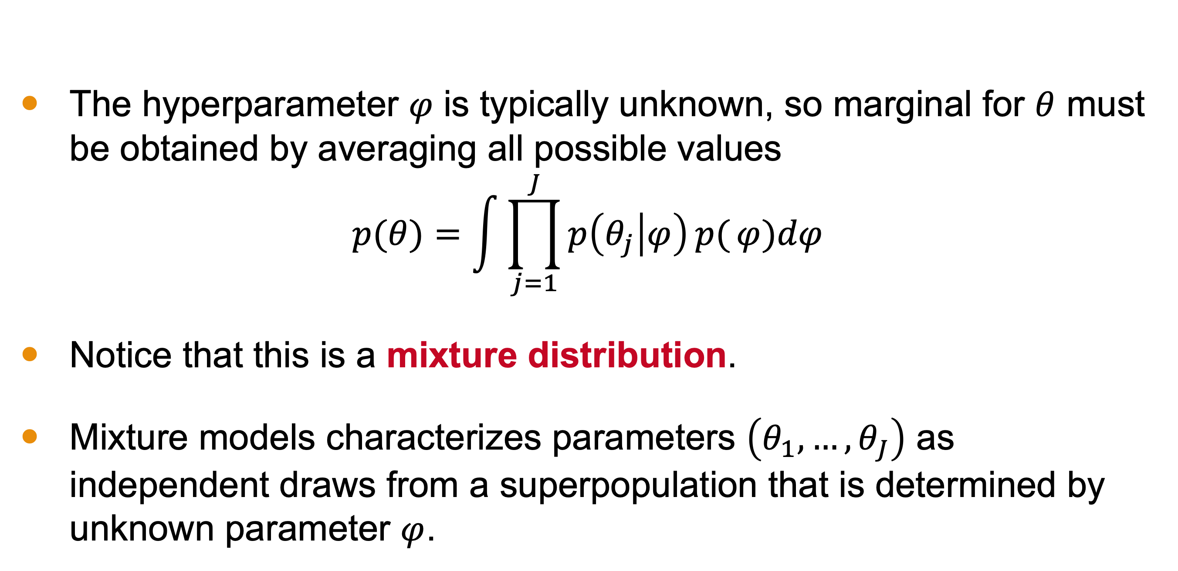
Unknown Hyperparameter $φ$
The hyperparameter 𝜑 is typically unknown, so marginal for $θ$ must be obtained by averaging all possible values
$$p(θ)=\int{\prod_{j=1}^{J}{p\left(θ_{j} | φ\right)}p(}φ)dφ$$
Notice that this is a mixture distribution.
Mixture models characterizes parameters $\left(θ_{1}, …,θ_{J}\right)$ as independent draws from a superpopulation that is determined by unknown parameter $φ$.
Notes:
The hyperparameter 𝜑 is typically theoretical and therefore unknown, so marginal for $θ$ must be obtained by averaging over all possible values of 𝜑
So we simply integrate over the theorized space for phi based on the hyperprior.
Notice that this is a mixture distribution—one that combines several distributions of “subpopulations.”
The hyperparameter \phi is typically unknown, so we obtain the marginal distribution for the parameters by averaging over all possible values of \phi. This results in a mixture distribution, combining several distributions of subpopulations determined by \phi.

Slide 17
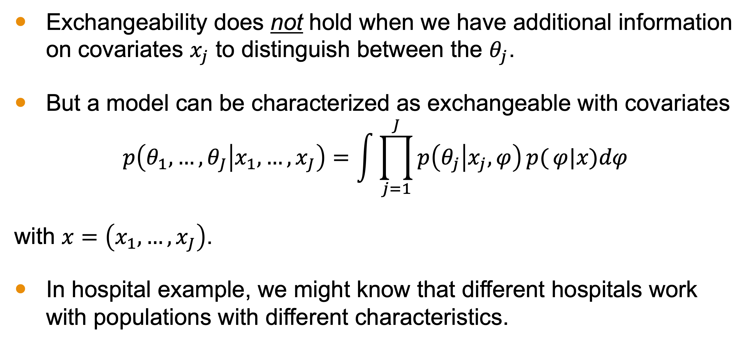
Covariates
Exchangeability does not hold when we have additional information on covariates $x_{j}$ to distinguish between the $θ_{j}$.
But a model can be characterized as exchangeable with covariates
$$p\left(θ_{1},…,θ_{J} | x_{1},…,x_{J}\right)=\int{\prod_{j=1}^{J}{p\left(θ_{j} | x_{j},φ\right)}p(}φ|x)dφ$$
with $x=\left(x_{1},…,x_{J}\right)$.
In hospital example, we might know that different hospitals work with populations with different characteristics.
Notes:
Exchangeability generally does not hold when we have additional information on covariates $x_{j}$ to distinguish between the $θ_{j}$.
But a model can be characterized as exchangeable with covariates using conditional independence.
In hospital example, we might know that different hospitals work with populations with different characteristics. This highlights that exchangeability does not imply that θj are all the same; just that they can be assumed to be draws from some common superpopulation distribution. So, if we incorporate covariates in this manner, we have a method for overcoming the primary challenge of exchangeability, assuming that contextual elements can be quantified as covariates.
Exchangeability does not hold when we have additional information on covariates that distinguish between the parameters. However, a model can be characterized as exchangeable with covariates using conditional independence. In the hospital example, we can account for differences in patient populations by incorporating covariates into the model.

Slide 18
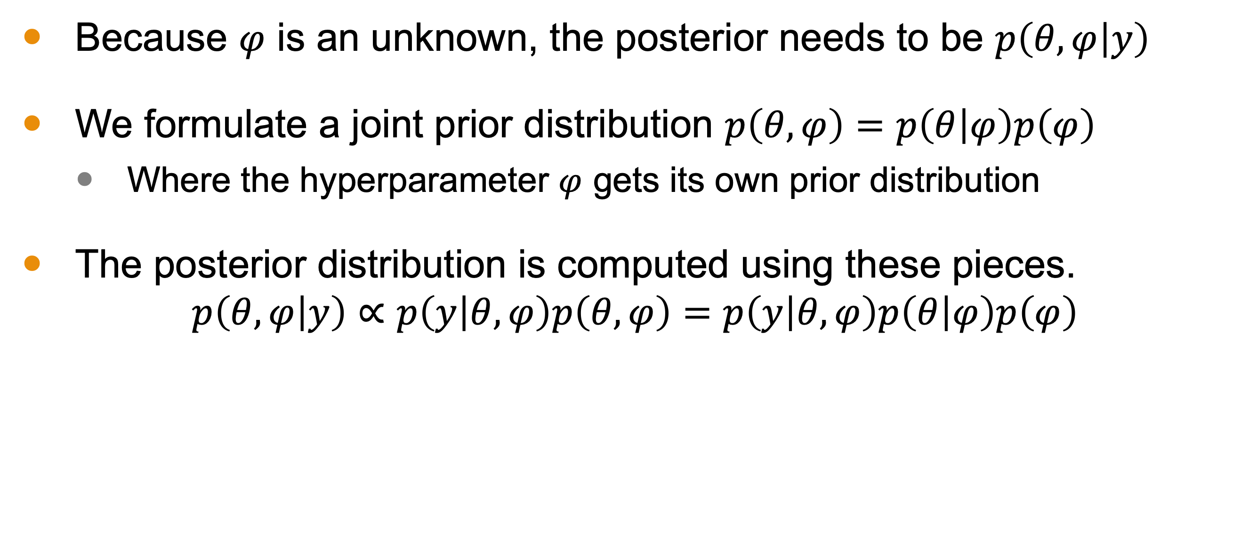
Fully Bayesian Hierarchal Model
Because $φ$ is an unknown, the posterior needs to be $p\left(θ,φ | y\right)$
We formulate a joint prior distribution $p\left(θ,φ\right)=p\left(θ | φ\right)p\left(φ\right)$
Where the hyperparameter $φ$ gets its own prior distribution
The posterior distribution is computed using these pieces.
$$p\left(θ,φ | y\right)∝p\left(y | θ,φ\right)p\left(θ,φ\right)=p\left(y | θ,φ\right)p\left(θ | φ\right)p\left(φ\right)$$
Notes:
In a fully Bayesian hierarchical model, the hyperparameter \phi is given its own prior distribution. The posterior distribution is computed using the joint prior distribution and the data. This approach allows us to account for uncertainty in the hyperparameters.

Slide 19
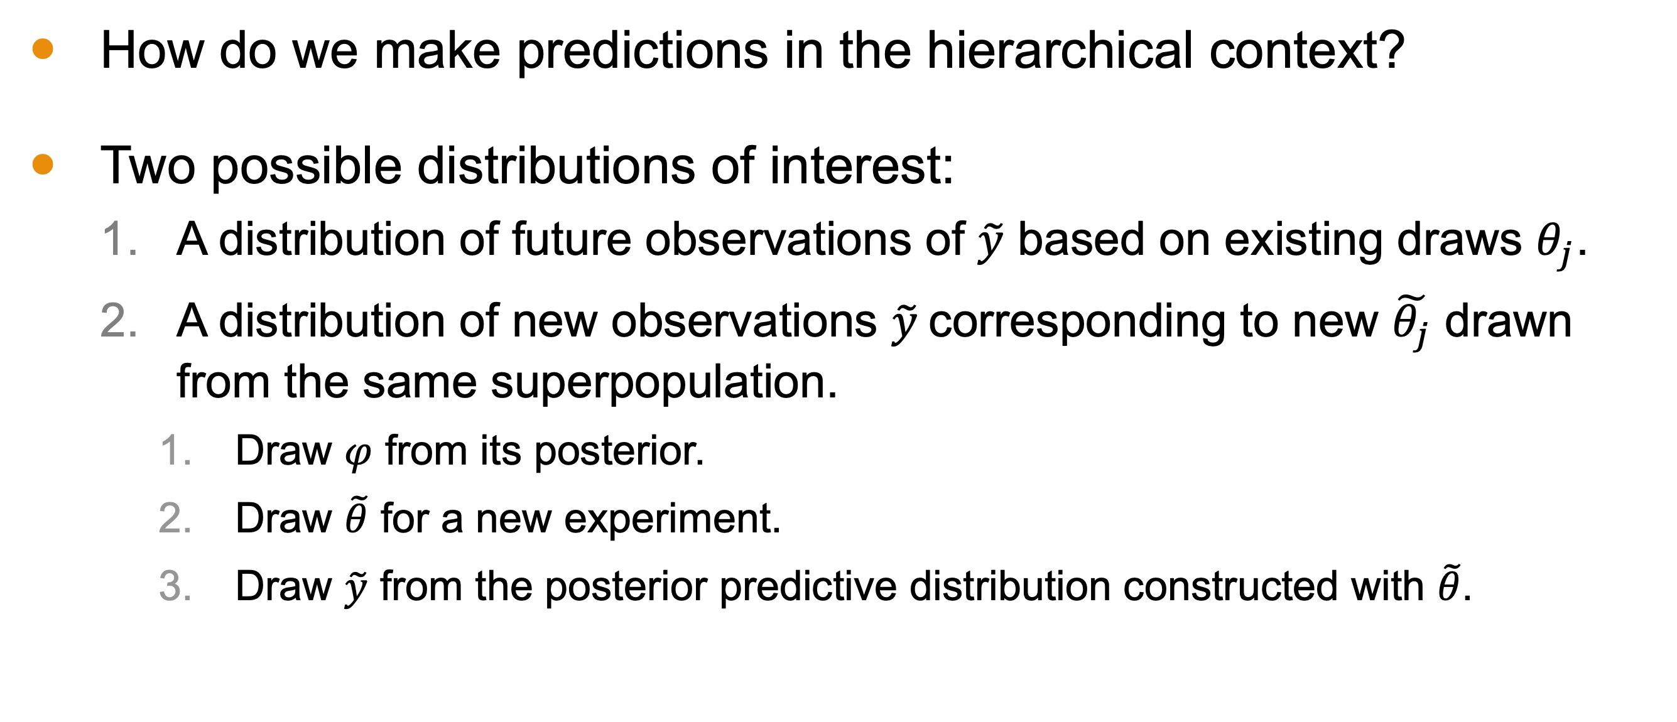
Posterior Predictive Distributions
How do we make predictions in the hierarchical context?
Two possible distributions of interest:
A distribution of future observations of $\tilde{y}$ based on existing draws $θ_{j}$.
A distribution of new observations $\tilde{y}$corresponding to new $\tilde{θ_{j}}$ drawn from the same superpopulation.
Draw $φ$ from its posterior.
Draw $\tilde{θ}$ for a new experiment.
Draw $\tilde{y}$ from the posterior predictive distribution constructed with $\tilde{θ}$.
Notes:
To make predictions in the hierarchical context, we consider two distributions:
1. Future observations based on existing parameters.
2. New observations corresponding to new parameters drawn from the same superpopulation.
We draw samples from the posterior distribution to simulate future data points and make predictions.

Slide 20
Next Time
Analysis and Applications of Hierarchical Models
Notes:
Using the overarching ideas covered in this lesson,
next time we will look at the analysis and applications of hierarchical models

